Slide 1
Student Record Manager
Course Instructor: N.AKHILA, M.Tech (Ph.D),ASSISTANT PROFESSOR,
AIML DEPTARTMENT
Presented By:
25B11AI494 | Kappala Hemanth Sai Venkata Vidya Sagar
25B11AI084 | Baluguri Ganesh
25B11AI320 | Gannabathula Sai
26B21AI0132 | Ayenavalli Keerthu Praveen

Slide 2
Contents
Project Abstract
Problem Statement & Objectives
Planned Modules / Functions
Users of the system
Modules/Functionalities
Architecture Diagram
ER Diagram / DFD
Planning and Timeline Diagram
Role of each individual

Slide 3
Project Abstract
Student Record Manager is a C++ application designed to store and manage student records using arrays.
It allows users to enter and search student details efficiently.
The system analyzes student marks and identifies the highest and lowest marks.
It also performs basic string handling operations on student information.
The project provides a simple and organized way to manage and display student records.

Slide 4
Problem Statement & Objectives
Problem Statement
Managing student records manually can be time-consuming and difficult when the number of students increases. Searching for a particular student and analyzing marks can also take more effort. A simple C++ system is needed to store student data using arrays, search records efficiently, and identify the highest and lowest marks.
Objectives
Store student data using arrays.
Search student records using ID or name.
Analyze student marks.
Find the highest and lowest marks.
Perform string handling operations.
Display student records and results clearly.

Slide 5
Planned Modules / Functions
Student Data Module – Stores student details using arrays.
Marks Module – Stores and manages student marks.
Search Module – Searches records using ID or name.
Marks Analysis Module – Finds highest and lowest marks.
String Handling Module – Processes student names and text.
Display Module – Displays student records and results.

Slide 6
Users of the System
Admin – Manages student records and system data.
Faculty / Staff – Enters and updates student marks.
Students – View their personal details and marks.
Exam Coordinator – Reviews and analyzes student performance.
Department Staff – Searches and maintains student records.

Slide 7
Modules / Functionalities
Student Data Management – Store and manage student details and marks.
Record Display – Display all student records.
Search Function – Search for a particular student record.
Marks Analysis – Find the highest and lowest marks.
String Handling – Manage student names and text data.
Menu-Driven Interface – Select and perform different operations easily.

Slide 8
Architecture Diagram
Presentation Layer
Console / Menu-driven User Interface
Business Logic Layer
Student Manager | Searching | Marks Analysis | String Handling
Data Layer
Arrays for student Details and Marks

Slide 9
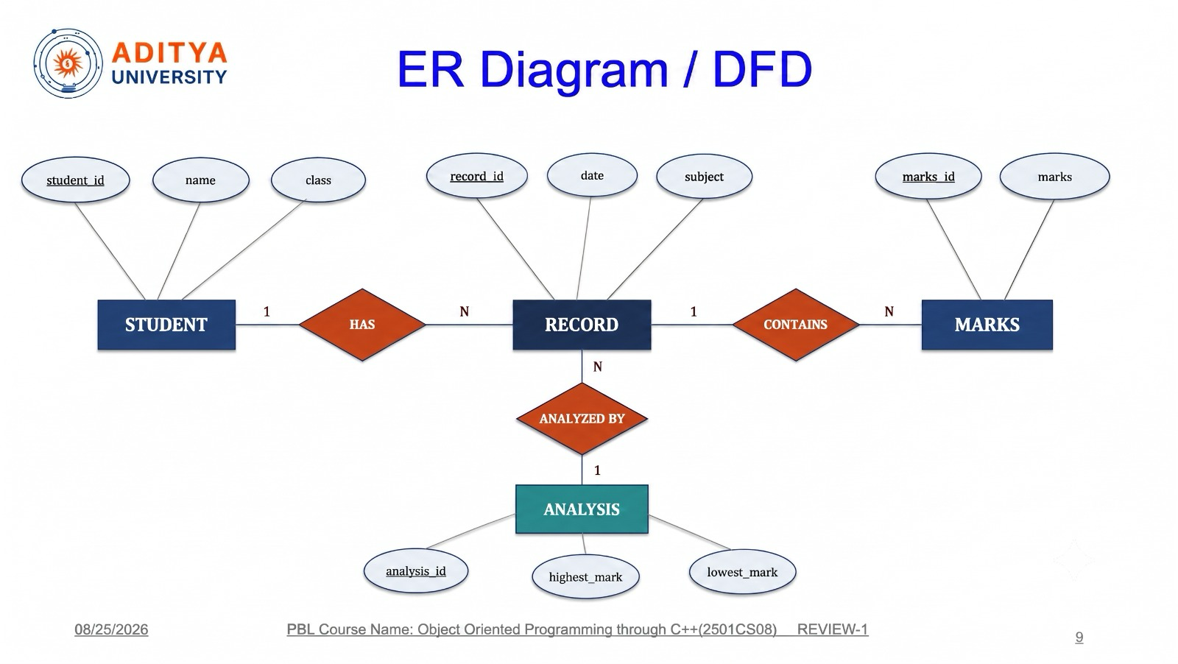
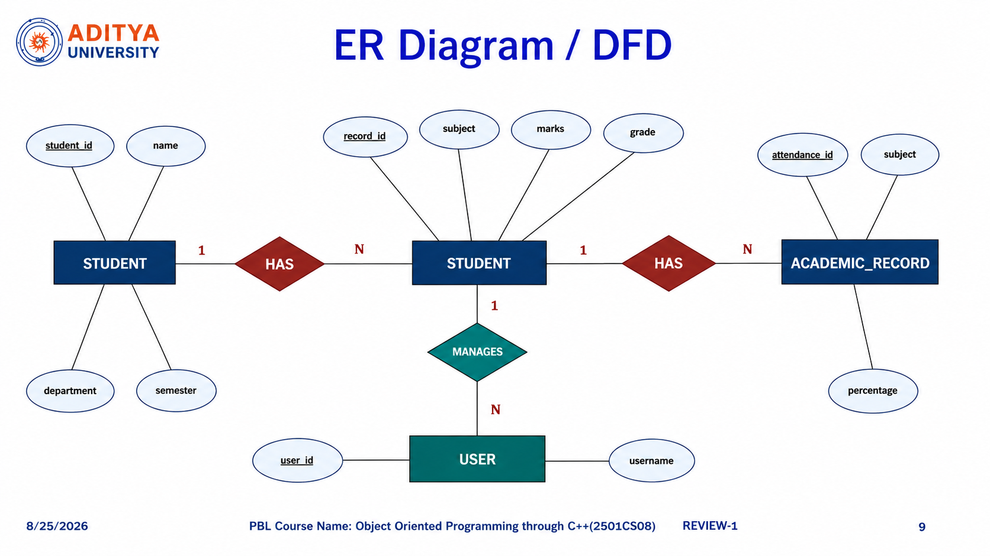
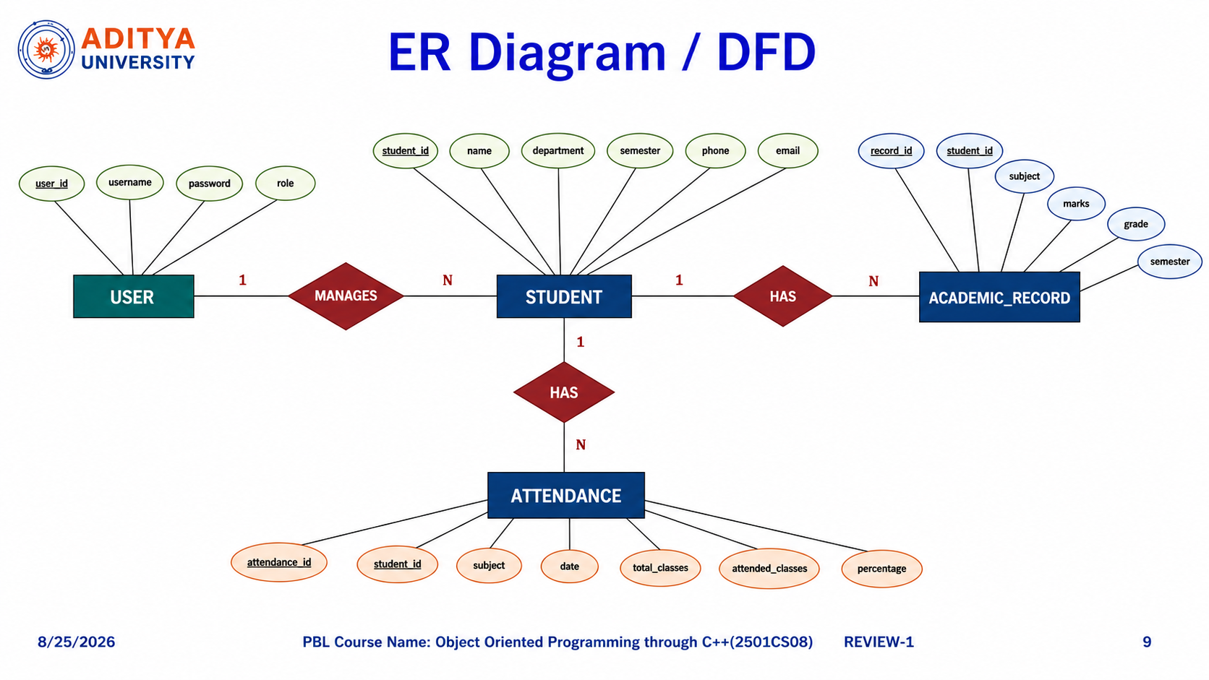
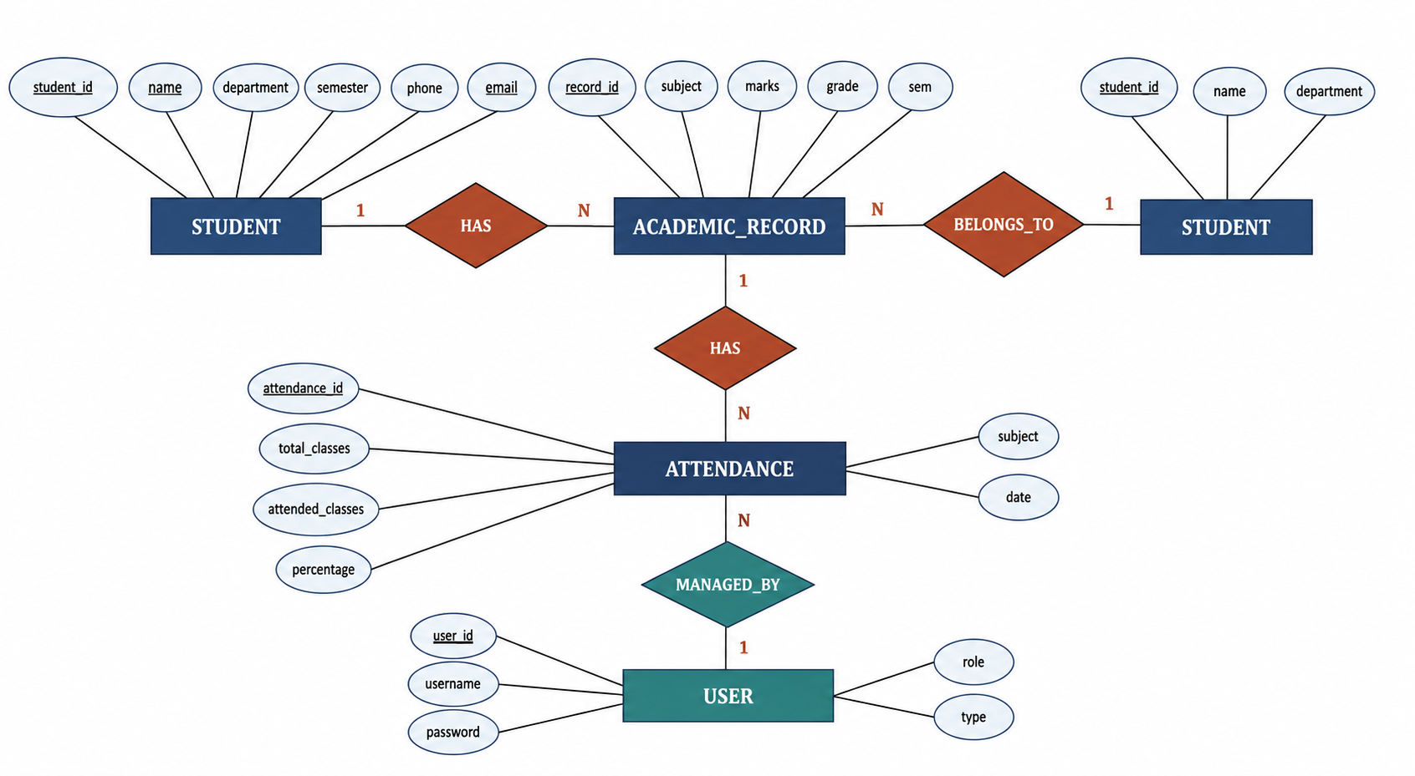
ER Diagram / DFD

Slide 10
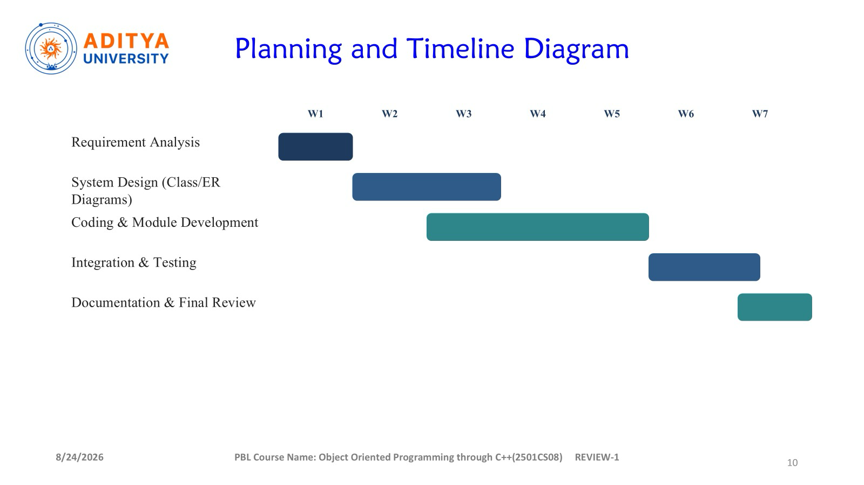
Planning and Timeline Diagram
W1
W2
W3
W4
W5
W6
W7
Requirement Analysis
System Design
Class & ER Diagram Design
Coding & Module Development
Integration & Testing
Documentation
Final Review & Presentation

Slide 11
Role of Each Individual
Roll No. | Name | Role / Responsibility
25B11AI494 | KAPPALA HEMANTH SAI VENKATA VIDYA SAGAR | Class design & Student Management
25B11AI084 | BALUGURI GANESH | Academic Module & File Handling
25B11AI320 | GANNABATHULA SAI | Attendance & Testing
26B21AI132 | AYENAVALLI KEERTHU PRAVEEN | Documentation & Presentation

Slide 12


